Slide 1
DATA STRUCTURE AND Algorithms
COURSE INTRODUCTION

Slide 2
Course overview
Attendance: 10%
Practice test 1: 20%
Practice Test 2: 10%
Final exam: 60%

Slide 3
Content
1
CHAPTER 1: COMPLEXITY
2
CHAPTER 2: SORTING AND SEARCHING
3
CHAPTER 3: ALGORITHMS STRATEGIES
4
CHAPTER 4: STACK AND QUEUE
5
CHAPTER 5: BINARY TREE
6
CHAPTER 6: GRAPHS

Slide 4
Practice …
https://www.spoj.com/PTIT/
https://codeforces.com/
https://vnoi.info/
https://www.hackerrank.com/
https://www.geeksforgeeks.org/
https://codelearn.io/

Slide 5
ONLINE PROGRAMMING TRAINING

Slide 6
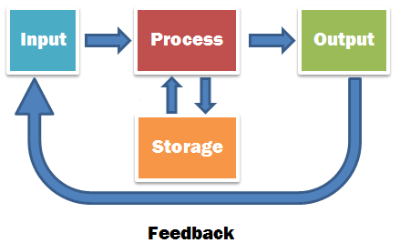
One program – basic level

Slide 7
And the result …
Run the program with the given input, compare with the standard output.
Return messages:
No, Compilation Error (CE): Compilation Error .
No, Wrong Answer (WA): Wrong answer . May not be in the correct format
No, Runtime Error (RTE): Runtime Exception Error. Maybe due to array overflow, division by 0, invalid memory access...
No, TimeLimit Exceeded (TLE): Running time exceeded (the specified time has expired but the program has not finished running)
No, Memory Limit Exceeded (MLE): Exceeded the allowable memory limit. Maybe because the recursion is too deep
No, Invalid Return (IR): The program returned an unexpected value. Maybe because some function is stopped midway (same fix as RTE).

Slide 8
Input
Read data correctly
The data type must match
Mastering the functions that read data
Know how to read when giving the question "number of test cases" and when not giving the number of tests

Slide 9
SIMPLE EXAMPLE OF OBJECTIVES

Slide 10
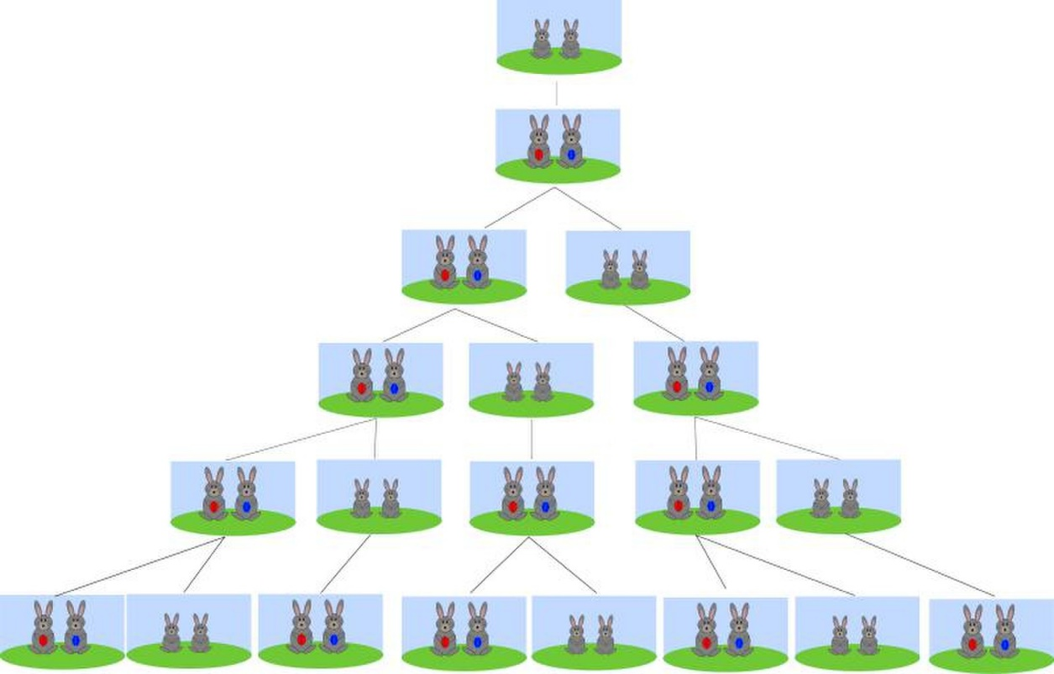
Fibonacci number problem

Slide 11
Fibonacci number problem
Example
F ₂₀ = 6765
F ₅₀ = 12586269025
F ₁₀₀ = 354224848179261915075
F ₅₀₀ = 13942322456169788013972438287040 7283950070256587697307264108962948325571622863290691 557658876222521294125

Slide 12
Fibonacci number problem
Request
- For a non-negative integer n
- Input: Number n (0 <= n <= 92)
- Output: nth Fibonacci number
Request time: 1s.

Slide 13
Fibonacci number problem
Eg
Input | Output
3 | 2
Input | Output
20 | 6756

Slide 14
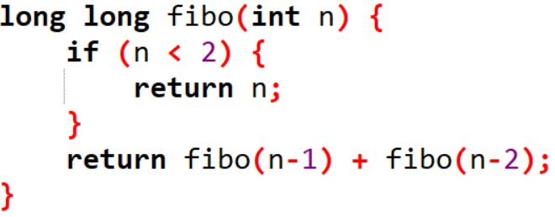
Fibonacci number problem
Algorithm 1

Slide 15
Fibonacci number problem
Evaluation of Algorithm 1
- Brief
- Easy to deploy, thinking in accordance with the requirements and description of the problem
- Results respond in less than 1s with n <= 40. However, with large n, the program is not able to respond immediately.

Slide 16
Fibonacci number problem
Estimated running time
- Call T(n) denotes the number of lines of command executed by function fibo (n)
- Consider n < 2, T = 2

Slide 17
Fibonacci number problem
Estimated running time
- Consider n >= 2, T(2) = 3?
T(n) = 2 + T(n-1) + T(n-2)

Slide 18
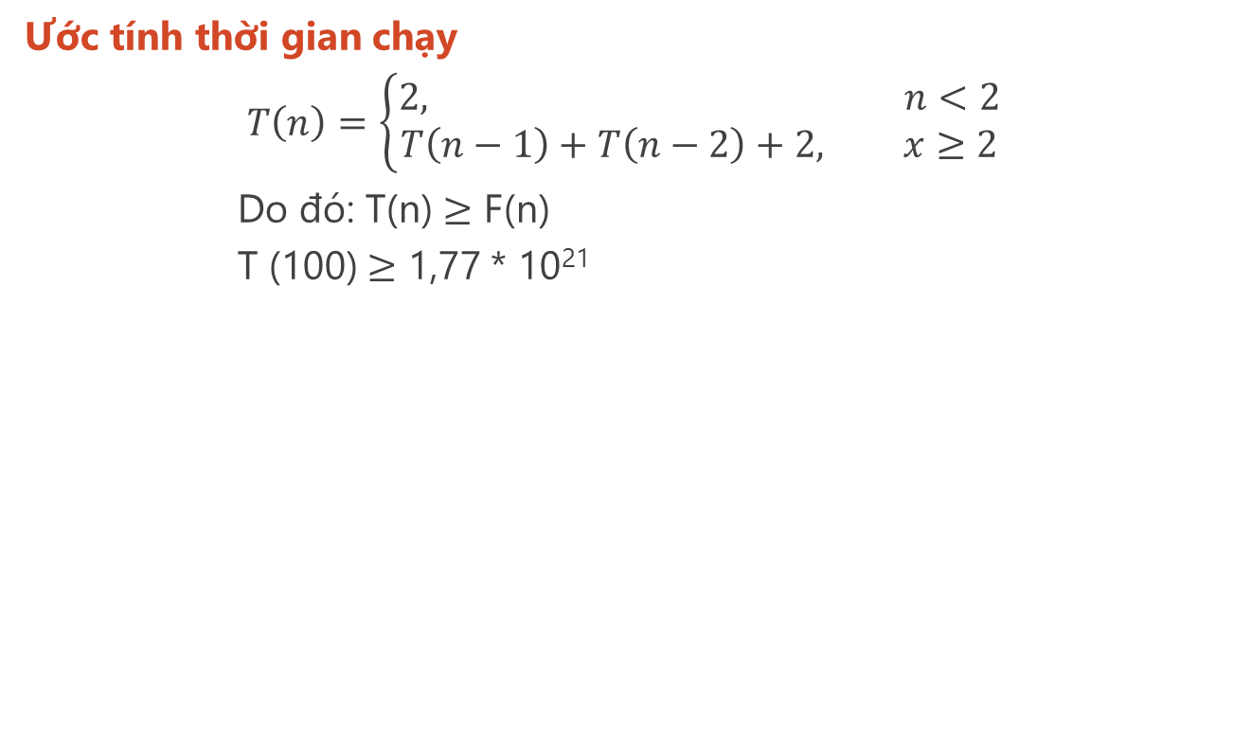
Fibonacci number problem

Slide 19
Fibonacci number problem
The reason algorithm 1 runs slow
- The number of function calls is too large and duplicated
- To calculate f(n), it is necessary to calculate f(n-1) and f(n-2) . To calculate f(n-1), we need to calculate f(n-2) and f(n-3), … => recursive tree

Slide 20
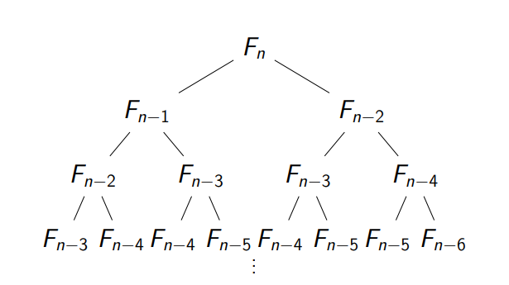
Fibonacci number problem
The reason why algorithm 1 runs slow

Slide 21
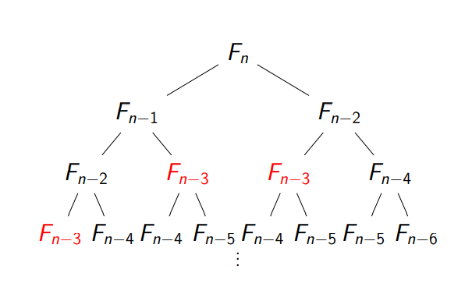
Fibonacci number problem
The reason why algorithm 1 runs slow

Slide 22
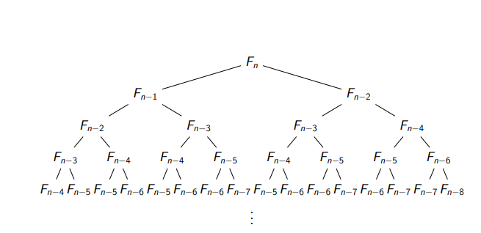
Fibonacci number problem
The reason why algorithm 1 runs slow

Slide 23
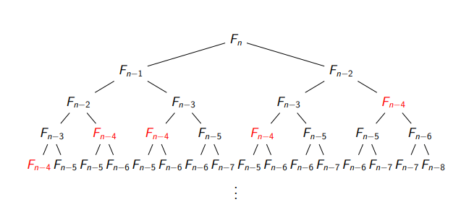
Fibonacci number problem
The reason why algorithm 1 runs slow

Slide 24
Fibonacci number problem
Algorithm 2
- Calculate by enumerating each element of the sequence
0, 1, 1, 2, …
- The next element is 1 + 2 = 3

Slide 25
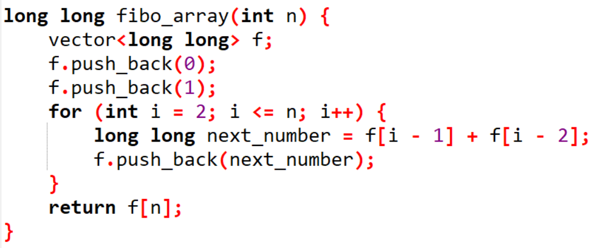
Fibonacci number problem
Algorithm 2

Slide 26
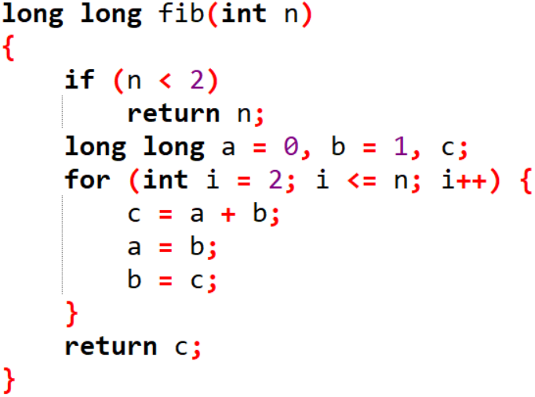
Fibonacci number problem
Algorithm 2

Slide 27
Fibonacci number problem
Estimated running time
T(n) = 4 + 2 * n T(100) = 204

Slide 28
Fibonacci number problem
Estimated running time
T(n) = 4 + 3 * n
T(100) = 304

Slide 29
EXTEND
How to calculate large Fibonacci numbers (Example F[100], F[500] … )
Number overflow problem
Runtime problem?
How to store results?
How to “Automatic Dot”

